Slide 1
Chapter 5 Exception handling

Slide 2
5.1 Introduction
An exception 异常 is an event, which occurs during the execution of a program, and disrupts the normal flow of the program's instructions.
The term exception is a shorthand for the phrase "exceptional event."
Creating an exception object and handing it to the runtime system is called throwing an exception 抛出异常.

Slide 3
5.1 Introduction
/**
* The size of the array a is 3, however this program tends to visit the 4th element.
* Therefore, an exception "ArrayIndexOutOfBoundsException" is thrown.
*/
public class ExampleArrayIndexOutOfBoundsException {
public static void main(String[] args) {
int[] a={10,20,30};
System.out.println(a[3]);
}
}
It displays:
Exception in thread "main" java.lang.ArrayIndexOutOfBoundsException: 3
at cn.edu.hbut.tjb.ExampleArrayIndexOutOfBoundsException.main(ExampleArrayIndexOutOfBoundsException.java:6)

Slide 4
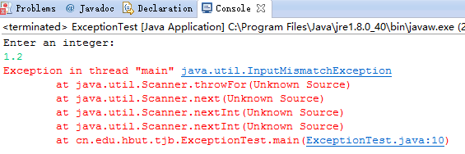
5.1 Introduction
import java.util.Scanner;
public class ExceptionTest {
public static void main(String[] args) {
Scanner sc = new Scanner(System.in);
System.out.println("Enter an integer: ");
int n = sc.nextInt();// If an exception occurs here, the rest code are skipped and the program is terminated
System.out.println("Your number is: " + n);
}
}

Slide 5
5.1 Introduction
Java allows the program to catch and handle exceptions in order to let the program resume from abnormal situations.
异常处理的目的是让程序从非正常状态中恢复

Slide 6
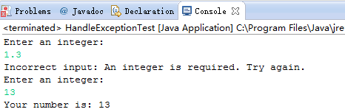
5.1 Introduction
import java.util.InputMismatchException;
import java.util.Scanner;
public class HandleExceptionTest {
public static void main(String[] args) {
Scanner sc = new Scanner(System.in);
boolean ok = false;
do {
try {
System.out.println("Enter an integer: ");
int n = sc.nextInt();
System.out.println("Your number is: " + n);
ok = true;
} catch (InputMismatchException e) {
System.out.println("Incorrect input: An integer is required. Try again.");
sc.nextLine();//discard the incorrect input
continue;
}
} while (!ok);
}
}

Slide 7
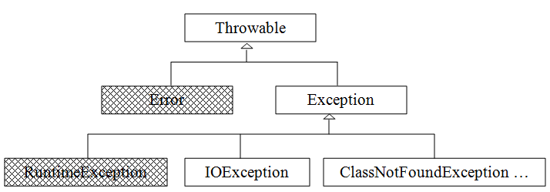
5.1 Introduction

Slide 8
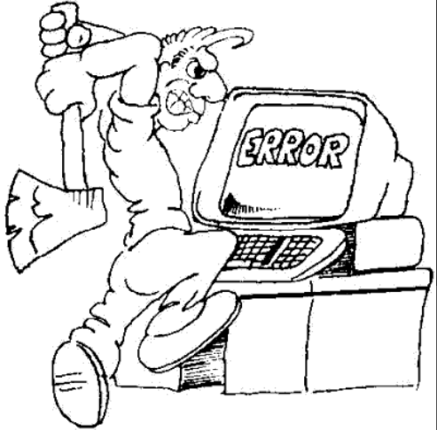
5.1 Introduction
An Error 错误 is a subclass of Throwable that indicates serious problems that a reasonable application should not try to catch.
Once an error happens, there is little one can do except terminating the program gracefully.
The Exception 异常 objects are caused by program and by external circumstances. They can be caught and handled in your programs.

Slide 10
异常类名称 | 异常类含义
ArithmeticException | 算术异常类
ArrayIndexOutOfBoundsException | 数组下标越界异常类
ArrayStoreException | 将与数组类型不兼容的值赋值给数组元素时抛出的异常
ClassCastException | 类型强制转换异常类
ClassNotFoundException | 为找到相应类异常
EOFException | 文件已结束异常类
FileNotFoundException | 文件未找到异常类
IllegalAccessException | 访问某类被拒绝时抛出的异常
InstantiationException | 试图通过newInstance()方法创建一个抽象类或抽象接口的实例时抛出的异常
IOException | 输入输出异常类
NegativeArraySizeException | 建立元素个数为负数的数组异常类
NullPointerException | 空指针异常类
NumberFormatException | 字符串转换为数字异常类
NoSuchFieldException | 字段未找到异常类
NoSuchMethodException | 方法未找到异常类
SecurityException | 小应用程序(Applet)执行浏览器的安全设置禁止的动作时抛出的异常
SQLException | 操作数据库异常类
StringIndexOutOfBoundsException | 字符串索引超出范围异常

Slide 11
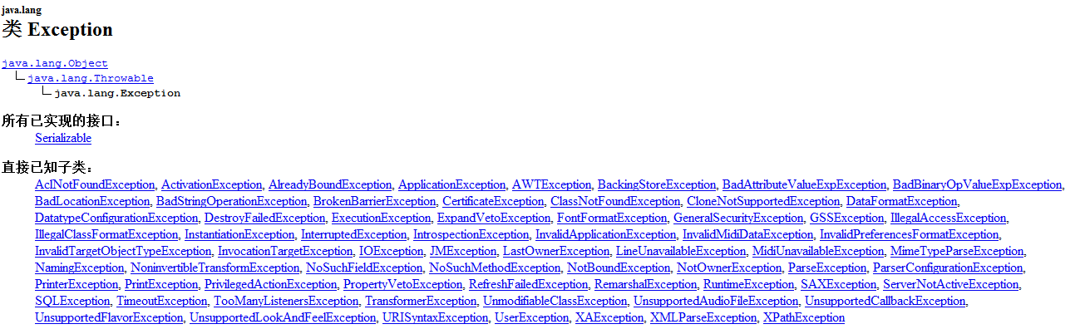
Predefined Exception Classes

Slide 12
5.1 Introduction
RuntimeException has several subclass such as
ArithmeticException,
IndexOutOfBoundsException,
NegativeArraySizeException,
NullPointerException,
ArrayStoreException,
ClassCastException,
IllegalArgumentException,
SecurityException,
IllegalMonitorStateException,
IllegalStateException,
UnsupportedOperationException.

Slide 13
5.1 Introduction
RuntimeExceptions are known as unchecked exceptions 免检异常.
All other exceptions are known as checked exceptions 检查异常, which imply that the compiler forces the programmer to check and deal with them.

Slide 14
5.1 Introduction
In most cases, unchecked exceptions reflect programming logic errors that are not recoverable.
For example, a NullPointerException
A checked exception needs to either be caught 捕获 in a catch block, or be thrown 抛出 on further via a throws clause of a method declaration.

Slide 15
5.1 Introduction
If an exception is a subclass of RuntimeException, it is an unchecked exception.
An unchecked exception can be caught, but it does not have to be. 可以被检查并处理，但不是必须
Class Error and its subclasses also are unchecked. Error也被视为免检
In general, you must always consider dealing with the possibility of a checked exception. If you don't, you will get a compilation error.

Slide 16
免检异常
编译器不强制要求程序员检查的异常
对于Java来说，所有RuntimException和Error及其子类均为免检
检查异常
如果程序有可能出现此类异常，则编译器强制要必须有相应检查和处理代码
对于Java来说，RuntimException以外所有异常均为检查

Slide 17
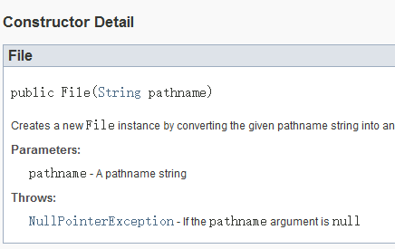
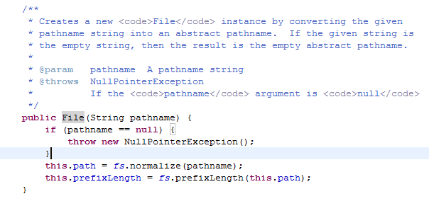

5.2 Handling Exceptions
Java code that might throw certain exceptions must be enclosed by either of the following:
A method that specifies that it might throw the exception. The method must provide a throws clause that lists the exception.

Slide 18
5.2 Handling Exceptions
IOEception is a kind of checked exception and it should be handled in your code.

Slide 19
5.2 Handling Exceptions
import java.io.File;
import java.util.Scanner;
public class ExampleThrows_1 {
public String getPassword() {
Scanner sc = new Scanner(new File("D:\\java\\test.txt"));//Compilation error:
return sc.next();
}
}

Slide 20
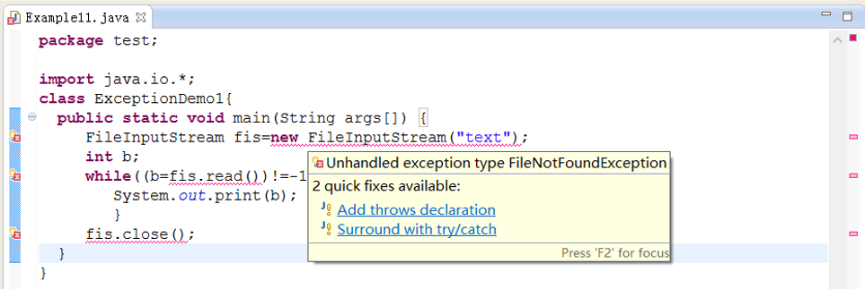
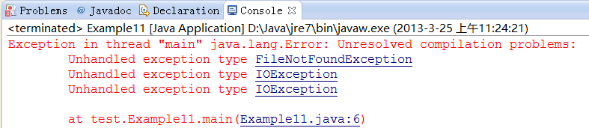

Slide 21
5.2 Handling Exceptions
import java.io.File;
import java.io.IOException;
import java.util.Scanner;
public class ExampleThrows_2 {
public String getPassword() throws IOException{
Scanner sc = new Scanner(new File("D:\\java\\test.txt"));
return sc.next();
}
}

Slide 22
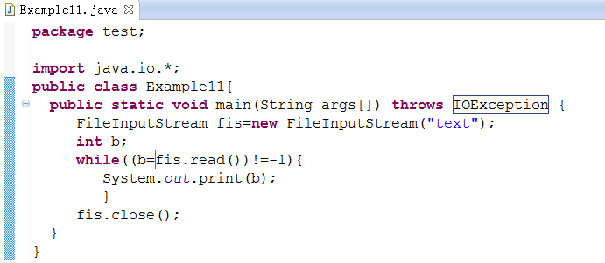
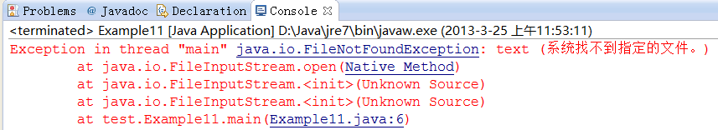

Slide 23
A try statement that catches the exception. The try must provide a handler for the exception.
在Java中，使用try块来监视可能产生异常的代码块。当异常产生后，使用catch块来捕获异常，并在其中对异常进行处理。

Slide 24
5.2 Handling Exceptions
import java.io.File;
import java.io.IOException;
import java.util.Scanner;
public class ExampleThrows_3 {
public String getPassword() {
Scanner sc = null;
String s = null;
try {
sc = new Scanner(new File("D:\\java\\test.txt"));
s = sc.next();
} catch (IOException e) {
// Return the detail message string of this e, possible null.
System.err.println(e.getMessage());
// Terminates the currently running Java Virtual Machine
System.exit(1);
}
return s;
}
}

Slide 25
5.2 Handling Exceptions
If the statement that caused the exception is inside a try block it goes to that code within the catch block accompanied the try block. 有try必有catch
After the catch clause is executed, execution resumes after the end of the entire try statement. 若catch被执行，try块内容恢复初始
It is impossible to return to the point at which the exception was thrown.

Slide 26
If there is no try statement around the code that threw the exception, Java goes up the call stack and looks at the statement that called this method, and checks for a try statement surrounding the call. 如果没有try块，虚拟机会找到调用此方法的方法，寻找是否有try块
If it finds an enclosing try statement that has a catch clause for this kind of exception, the catch clause is executed and then execution continues from the immediately following statement of that try statement.
Java continues moving up the call stack until it finds an enclosing try statement.
If no enclosing try statement and catch clause is found, the exception-handling system receives the exception and prints an error message and terminates the program.全部调用过程无try块则系统按默认方式输出错误信息，并终止程序

Slide 27
5.2 Handling Exceptions
The code that handles the exception in catch block is known as an exception handler.
A try block may associate exception handlers in one or more catch blocks
The process of looking for a handler is called catching an exception.

Slide 28
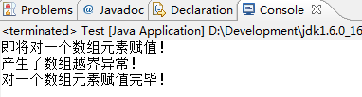
异常捕获示例
public class Test
{
public static void main(String[] args)
{
int a[] = new int[3];
System.out.println("即将对一个数组元素赋值！");
try
{
a[3] = 25;
System.out.println("能执行这行代码吗！");
}
catch(ArrayIndexOutOfBoundsException e)
{
System.out.println("产生了数组越界异常！");
}
System.out.println("对一个数组元素赋值完毕！");
}
}

Slide 29
5.2 Handling Exceptions
try {
// code block that may throw exceptions
} catch (ArithmeticException e) {
// Code bloack for handling an ArithmeticException exception
} catch (IndexOutOfBoundsException e) {
// Code block for handling an IndexOutOfBoundsException exception
}

Slide 30
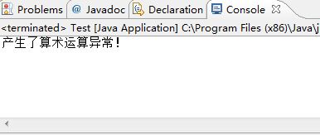

多catch语句示例
public class Test{
public static void main(String[] args) {
int a[] = new int[3];
try
{
a[3] = 10;
a[3] = 2/0;
}
catch(ArithmeticException e)
{
System.out.println("产生了算术运算异常！");
}
catch(ArrayIndexOutOfBoundsException e)
{
System.out.println("产生了数组越界异常！");
}
catch(Throwable e)
{
System.out.println("产生了数组越界异常！");
}
}
}

Slide 31
5.2 Handling Exceptions
A match means that the thrown object can legally be assigned to the exception handler's argument.
In other words, matching an exception doesn’t require strict equality between the exception and its handler. A derived-class object will match a handler for the base class.
异常可以匹配其父类
try{
int age=Integer.parseInt("24L"); //抛出NumberFormatException异常
}catch(Exception e){ //先捕获Exception异常
System.out.println(“捕获到异常”);
}catch(NumberFormatException e){ //捕获异常类Exception的子类异常
System.out.println(“捕获到数字格式异常”);
}

Slide 32
5.3 The finally Block
The try-block statement has the general form:
try{
}catch(Exception <object_name>){
}finally{
}
finally creates a block of code that will be executed after the try/catch block is completed.
The finally block will execute whether or not an exception is thrown.

Slide 33
5.3 The finally Block
import java.io.File;
import java.io.IOException;
import java.util.Scanner;
public class ExampleThrows_4 {
public String getPassword() {
Scanner sc = null;
String s = null;
try {
sc = new Scanner(new File("D:\\java\\test.txt"));
s = sc.next();
} catch (IOException e) {
// Return the detail message string of this e, possible null.
System.err.println(e.getMessage());
// Terminates the currently running Java Virtual Machine
System.exit(1);
} finally {
if (sc != null) {
sc.close();
}
}
return s;
}
}

Slide 34
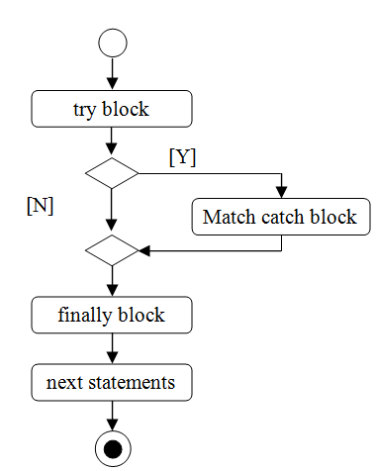
5.3 The finally Block

Slide 35
5.3 The finally Block
import java.io.IOException;
import java.io.PrintWriter;
public class FinallyTest {
public static void main(String[] args) {
PrintWriter output = null;
try {
output = new PrintWriter("test.txt");
output.println("Finally block test.");
} catch (IOException e) {
System.out.println(e.getMessage());
System.exit(0);
} finally {
if (output != null) {
output.close();
}
}
}
}
To ensure that a file closes under all circumstances, there is usually a file closing statement in the finally block

Slide 36
5.3 The finally Block
Exception handling separates the code executed in an abnormal state from normal execution.
This arrangement makes programs easier to read and to modify.

Slide 37
5.3 The finally Block
In general, simple exceptions that may occur in individual methods are best handled locally without throw.
When a method has to deal with an unexpected exception, a try-catch block should be used.

Slide 38
5.4 User-defined Exceptions
When you are going to use your own exceptions, there are three steps:
defining an exception,
declaring throws,
and using the exception.

Slide 39
5.4 User-defined Exceptions
Defines the user exception OutOfScoreRangeException
public class OutOfScoreRangeException extends Exception{
public OutOfScoreRangeException(String msg, int score) {
super(msg);
this.score = score;
}
public int getScore() {
return this.score;
}
private int score;
}

Slide 40
5.4 User-defined Exceptions
throw exceptions for the proper situation using the throw statement
public class Score {
public Score(int s) throws OutOfScoreRangeException {
if (s <= 100 && s >= 0) {
score = s;
} else {
throw new OutOfScoreRangeException("Out of score range exception ", s);
}
}
private int score;
}

Slide 41
5.4 User-defined Exceptions
public class TestScore {
public static void main(String[] args) {
try {
Score s1 = new Score(98);
Score s2 = new Score(800);
System.out.print(s1);
System.out.print(s2);
} catch (OutOfScoreRangeException e) {
System.out.println(e.getMessage() + e.getScore());
}
}
}

Slide 42
5.5 Benefits of Java Exception Handling Framework
Benefits: The Java exception handling framework provides the ability to separate error handling code from regular code.
分离异常情况和正常情况处理的代码

Slide 43
5.5 Benefits of Java Exception Handling Framework
public static void main(String[] args) {
Stack s1 = new ArrayStack();
if (s1.pop())
System.out.println("The element on the top has been released.");
else {
System.out.println("No element on the top has been released since the stack is empty.");
}
}
This kind of code portion is hard to read and understand for programmers.

Slide 44
5.5 Benefits of Java Exception Handling Framework
Exception approach:
public static void main(String[] args) {
Stack s1 = new ArrayStack();
try {
s1.pop();
} catch (Exception e) {
System.out.println(e.getMessage());
}

Slide 45
5.5 Benefits of Java Exception Handling Framework
Note that the pop() method used in Code 5.15 could be declared as:
public void pop() throws Exception {
if (this.isEmpty())
throw new Exception(this + " is empty");
else {
topOfStack--;
}
}

Slide 46
5.5 Benefits of Java Exception Handling Framework
/*
* readFile.c
*/
int readFile() {
initialize errorCode = 0;
//open the file;
if (theFileIsOpen) {
//determine the length of the file;
if (gotTheFileLength) {
//allocate that much memory;
if (gotEnoughMemory) {
//read the file into memory;
if (readFailed) {
errorCode = -1;
}
} else {
errorCode = -2;
}
} else {
errorCode = -3;
}
//close the file;
if (theFileDidntClose && errorCode == 0) {
errorCode = -4;
} else {
errorCode = -4;
}
} else {
errorCode = -5;
}
return errorCode;
}
confuse readers

Slide 47
5.5 Benefits of Java Exception Handling Framework
import java.io.File;
import java.io.FileNotFoundException;
import java.util.Scanner;
public class FlowSeperation {
public static void main(String[] args) {
Scanner src = null;
try {
src = new Scanner(new File("D:\\java\\Test.txt"));
while (src.hasNext()) {
System.out.println(src.next());
}
} catch (FileNotFoundException ex) {
System.exit(1);
} finally {
if (src != null) {
src.close();
}
}
}
}

Slide 48
5.5 Benefits of Java Exception Handling Framework
Benefit: The method can ignore any exceptions thrown within it in case the method has no idea how to process them

Slide 49
5.5 Benefits of Java Exception Handling Framework
import java.io.File;
import java.io.FileNotFoundException;
import java.util.Scanner;
public class FlowSeperation {
public static void main(String[] args) throws FileNotFoundException {
Scanner src = null;
try {
src = new Scanner(new File("D:\\java\\Test.txt"));
while (src.hasNext()) {
System.out.println(src.next());
}
} finally {
if (src != null) {
src.close();
}
}
}
}

Slide 50
5.5 Benefits of Java Exception Handling Framework
The Java exception handling framework helps to group exception types.

Slide 51
5.6 Assertions
An assertion is an expression that represents a condition that a programmer believes to be true at a specific place in a program.
If an assertion isn’t true, an error occurs.

Slide 52
断言：是一种错误处理机制，是在程序的开发和测试阶段使用的工具
语法如下：
assert 条件表达式
或者
assert 条件表达式：字符串表达式
这两个形式都会对“条件”进行判断， “条件”是一个布尔表达式。如果判断结果为假（false）则抛出AssertionError。在第二种形式中，“字符串表达式”会传进AssertionError的构造函数中并转成一个消息字符串。

Slide 53
5.6 Assertions
The assert keyword is followed by a conditional expression.
public class Score {
public Score(int s) {
assert s <= 100 && s >= 0;
score = s;
}
private int score;
}
public class AssertionTest {
public static void main(String[] args) {
Score s = new Score(101);
}
}

Slide 54
5.6 Assertions
If the assertion that follows the assert keyword is not true, an AssertionError exception is thrown.
To make the error message associated with an assertion more meaningful, you can specify a string in an assert statement, as in the following example:
assert s <= 100 && s >= 0: "Score >100 or score < 0";

Slide 55
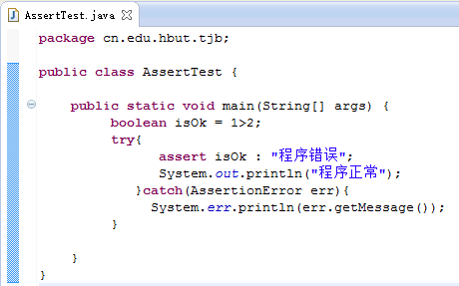
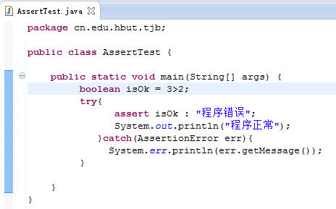



Slide 56
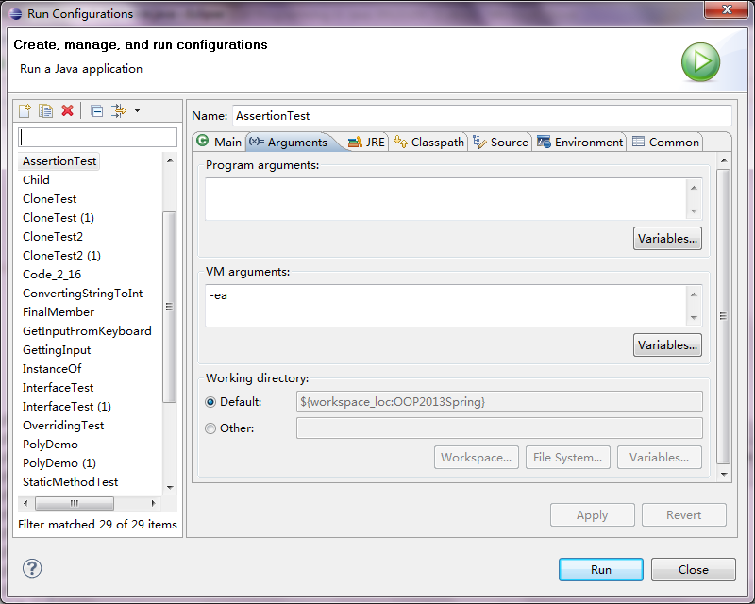
打开和关闭断言功能
默认情况下，断言是关闭的。要通过-enableassertions或者-ea选项来运行程序以打开断言：
java –ea Myapp

